Slide 1
Unit 5 :
Performing advanced queries
Session 4
Databases

Slide 2
Summary or aggregate queries
Record Grouping

Slide 3
Summary queries
Summary or aggregate queries allow you to perform summary or group calculations on rows that have the same value in one or more columns.
Aggregate functions are used to perform these calculations .
Count(expression or column): Counts how many rows there are with the expression or column that are not null. If we write * in the function argument, how many rows there are in the query are counted. If the expression or column is null, it is not counted.
Sum( expression or column ): Calculates the sum of the numerical values indicated in the argument. If there is null in the expression or column , it is not taken into account for the sum.
Min( expression or column ): Obtains the minimum value of the indicated argument.
Max( expression or column ): Gets the maximum value of the indicated argument.
Avg( expression or column ): Obtains the arithmetic mean of the indicated argument. Does not consider null values for the calculation of the mean.
Group_concat( expression or column ): Obtains the concatenation of all the values that would be obtained in the query. Does not consider null values for concatenation.

Slide 4
Summary queries
Example: Obtain how many contracts have been made:
SELECT count(*) FROM contracts;
Example: Obtain how many contracts made have ended.
SELECT count(ffin) FROM contracts;
Example: Get how many cars there are.
SELECT count(*) FROM cars;
Example: Obtain how many brands there are cars.
SELECT count(DISTINCT brand) FROM cars;
Without DISTINCT, it would output how many cars there are in the CARS table (how many rows have the brand column with non-null values). With DISTINCT, repeated rows of the same brand are not counted. For each mark one more is counted.

Slide 5

Summary queries
Example: Obtain the average number of kilometers traveled in completed contracts, the maximum mileage completed and the minimum.
SELECT avg(kfin-kini), max(kfin-kini),min(kfin-kini) FROM contracts;

Slide 6

Summary queries
Example: Obtain a string of concatenated characters of the names of all Toledo customers.
SELECT group_concat(name) FROM clients WHERE location='toledo';

Slide 7

Summary queries
Example: Obtain the total sum of kilometers traveled in contracts completed by clients in Madrid.
SELECT sum(kfin-kini) FROM contracts INNER JOIN clients ON dnicliente=dni WHERE locality='madrid';

Slide 8

Record Grouping
The GROUP BY clause allows multiple rows of a query to be grouped by one or more expressions. All repeated values of grouped expressions will be displayed in a single row.
Example: Obtain the make and model (without repeating) of all the cars that were contracted and whose contract end date is within the year 2018.
SELECT make,model FROM automobiles INNER JOIN contracts ON contracts.matricula = automobiles.matricula WHERE year(ffin)=2018 GROUP BY make,model;

Slide 9

Record Grouping
Example: Obtain the locations where you have clients.
SELECT location FROM customers GROUP BY location;

Slide 10
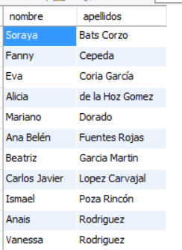
Record Grouping
Example: Obtain the first and last name of the clients who have made contracts after December 24, 2017. The results must be sorted ascending by last name and first name.
SELECT name,last name FROM clients INNER JOIN contracts ON dniclient=dni WHERE fini >='2017-12-24' GROUP BY dniclient ORDER BY last name,name;

Slide 11
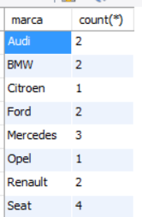
Record Grouping
Get calculations on groups of records or rows
When grouping is done in a SELECT, we can obtain calculations on each group with the summary or aggregate functions we have seen.
Example: Obtain how many cars there are of each brand using the count function. You have to group by brand in a query on the automobiles table.
SELECT brand,count(*) FROM cars GROUP BY brand;

Slide 12
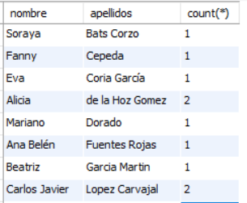
Record Grouping
Example: Obtain the name and surname of the clients who have made contracts since December 24, 2017 and how many contracts they have made since that date. The results must be sorted ascending by last name, first name.
SELECT firstname,lastname,count(*) FROM clients INNER JOIN contracts ON clientdn=dni WHERE fini >='2016-12-27' GROUP BY clientdn ORDER BY lastname,name;

Slide 13
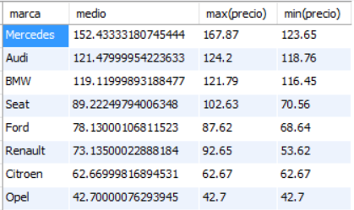
Record Grouping
Example: Obtain the average price, maximum price and minimum price of the cars of each brand ordered descending by average price.
SELECT brand,avg(price)AS average ,max(price),min(price) FROM automobiles GROUP BY brand ORDER BY average DESC;

Slide 14

Record Grouping
Example: Obtain the average price, maximum price and minimum price of SEAT brand cars.
SELECT avg(price),max(price),min(price) FROM cars WHERE brand='SEAT' ;

Slide 15
Record Grouping
Put conditions on results of grouping functions. HAVING Clause:
In a query, you can select rows that satisfy conditions related to the result of a grouping function.
A selection condition must be written after HAVING .
Only grouping or summary functions, grouping columns (those used with GROUP BY), or any expression based on these columns or grouping functions can be used in the selection condition.
Example: Obtain the number of clients in each location as long as there are more than three clients in the location.
SELECT locality,count(*) FROM customers GROUP BY locality HAVING count(*)>3 ;

Slide 16

Record Grouping
Example: Obtain the car brands whose average rental price is less than 105 Euros.
SELECT brand FROM cars GROUP BY brand HAVING avg(price)<105;

Slide 17
Record Grouping
Example: Obtain the car brands and their average rental price as long as this average price is between 75 and 100 euros.
SELECT brand,avg(price) AS average FROM automobiles GROUP BY brand HAVING average >=75 AND average<=100;

